Slide 1
Efficient Algorithms for Finding a Longest Common Increasing Subsequence
ISAAC, pp. 665-674, 2005
Reporter: Chiou-Ting Tseng
Date: Oct. 19, 2006

Slide 2
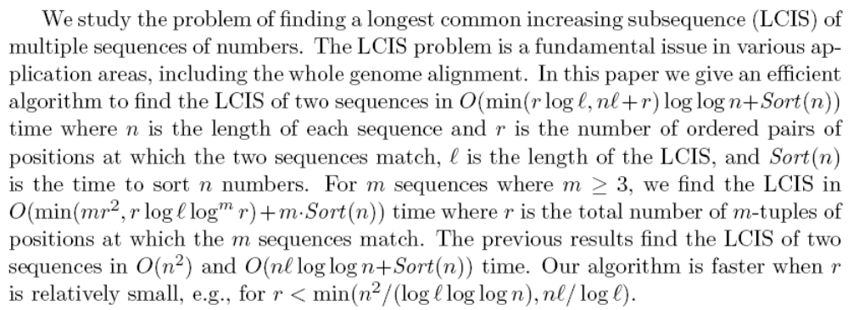
Abstract

Slide 3
The Longest Common Increasing Subsequence (LCIS) Problem
Definition:
  Input: Two numeric sequences S₁, S₂
  Output: The longest common increasing subsequence of S₁ and S₂.
Example: Given S₁=35274816 and S₂=51724863, the LCIS of S₁ and S₂ is 246
This problem can be solved by applying the RSK algorithm on the table for finding LCS(Chao’s Algorithm).
(See the example on the next page.)

Slide 4
Chao’s Algorithm for CLIS
 | 3 | 5 | 2 | 7 | 4 | 8 | 1 | 6
5 | - | L1: 5 | L1: 5 | L1: 5 | L1: 5 | L1: 5 | L1: 5 | L1: 5
1 | - | L1: 5 | L1: 5 | L1: 5 | L1: 5 | L1: 5 | L1: 1 | L1: 1
7 | - | L1: 5 | L1: 5 | L1: 5 L2: 7 | L1: 5 L2: 7 | L1: 5 L2: 7 | L1: 1 L2: 7 | L1: 1 L2: 7
2 | - | L1: 5 | L1: 2 | L1: 2 L2: 7 | L1: 2 L2: 7 | L1: 2 L2: 7 | L1: 1 L2: 7 | L1: 1 L2: 7
4 | - | L1: 5 | L1: 2 | L1: 2 L2: 7 | L1: 2 L2: 4 | L1: 2 L2: 4 | L1: 1 L2: 4 | L1: 1 L2: 4
8 | - | L1: 5 | L1: 2 | L1: 2 L2: 7 | L1: 2 L2: 4 | L1: 2 L2: 4 L3: 8 | L1: 1 L2: 4 L3: 8 | L1: 1 L2: 4 L3: 8
6 | - | L1: 5 | L1: 2 | L1: 2 L2: 7 | L1: 2 L2: 4 | L1: 2 L2: 4 L3: 8 | L1: 1 L2: 4 L3: 8 | L1: 1 L2: 4 L3: 6
3 | L1: 3 | L1: 3 | L1: 2 | L1: 2 L2: 7 | L1: 2 L2: 4 | L1: 2 L2: 4 L3: 8 | L1: 1 L2: 4 L3: 8 | L1: 1 L2: 4 L3: 6

Slide 5
Find All Matches
A=3_{a}4_{a}2_{a}3_{b}4_{b}2_{b}3_{c}, B=4_{d}2_{d}3_{d}4_{e}3_{e}2_{e}4_{f}
Sort A and B independently
A’=2_{a}2_{b}3_{a}3_{b}3_{c}4_{a}4_{b}, B’=2_{d}2_{e}3_{d}3_{e}4_{d}4_{e}4_{f}
Sequentially scan A’ and B’ to get all matches.
O(nlogn + r)

Slide 6
Rank the Matches
A=3_{a}4_{a}2_{a}3_{b}4_{b}2_{b}3_{c}, B=4_{d}2_{d}3_{d}4_{e}3_{e}2_{e}4_{f}
A’=2_{a}2_{b}3_{a}3_{b}3_{c}4_{a}4_{b}, B’=2_{d}2_{e}3_{d}3_{e}4_{d}4_{e}4_{f}
Rank(4_{a},4_{d})=1
Rank(3_{b}, 3_{d})=Rank(2_{a}, 2_{d})+1=2
Rank(4_{b}, 4_{e})=Max{ Rank(3_{a}, 3_{d}), Rank(3_{b}, 3_{d}), Rank(2_{a}, 2_{d})}+1=3
O(r²), r may be O(n²)

Slide 7
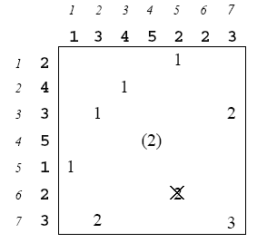
Critical Match

Slide 8
Critical Match
A match (i, j) in a partition is called a critical match if there is no match (i’, j’) of the same partition with i’< i and j’<j.

Slide 9
Implementation 1
 | 1 | 3 | 4 | 5 | 2 | 2 | 3
2 |  |  |  |  | 5 | 3
4 |  |  | 10
3 |  | 9 |  |  |  |  | 7
5 |  |  |  | 11
1 | 1
2 |  |  |  |  | 4 | 2
3 |  | 8 |  |  |  |  | 6

Slide 10
Implementation 1
Sort A, B and find all matches.
Store the critical matches of rank i in vEB tree i.
Find the largest rank dominating match by binary search on the trees. O(log l loglog n)
Remove every match which becomes non-critical.

Slide 11
Implementation 1
Time: O( n log n+ r)+ r [O( log l log log n )+ O( loglog n)]+ O( r loglog n) =O( rlog l loglog n+ n log n)

Slide 12
Implementation 2
 | 1 | 3 | 4 | 5 | 2 | 2 | 3
2 |  |  |  |  | 3-1 | 2-1
4 |  |  | 6
3 |  | 5-1 |  |  |  |  | 4-1
5 |  |  |  | 7
1 | 1
2 |  |  |  |  | 3-2 | 2-2
3 |  | 5-2 |  |  |  |  | 4-2

Slide 13
Implementation 2
Sort A, B and find all matches.
Store the critical matches of rank i in vEB tree i.
Apply sequential search on the group with the same v and the same j for i from small to large.
Remove every match which becomes non-critical.

Slide 14
Implementation 2
For each group, at most l + g times of search is required.
Totally nl + r search is required.

Slide 15
Implementation 2
Time: O( n log n+ r)+ O( (nl + r) log log n)+ O( r log log n) = O( (nl + r) log log n+ n log n)

Slide 16

LCIS of m Sequences
A match is a dominating match of another match if all coordinates are smaller and value is smaller.

Slide 17
Multidimensional Orthogonal Range Queries(1)
Given a set of N points in d-dimensional Euclidean space, each associated with a numerical value, design a data structure for the points that supports efficient insertion, deletion, and query of the form: return a point that falls within a hyper-rectangular region [x₁,y₁] × [x₂, y₂] × ... ×[x_{d}, y_{d}].

Slide 18
Multidimensional Orthogonal Range Queries(2)
There is a data structure for the above problem that supports each update and query in O(log^{d}N) time, using space O(Nlog^{d-1}N).

Slide 19
LCIS of m Sequences
Check if there is any match (or point) of the partition that falls within the hyper-rectangular region [1,i₁-1] × [1,i₂-1] × ... × [1,i_{m}-1].
Time: O(mr logl log^{m}r + mn log n).

Slide 20
Implementation 1
The matches are arranged in ascending order of their values.
For the matches (i, j) with the same value, they are arranged in descending order of j and then i.

